Slide 1
Welcome to Your Pediatric Rotation!
Ramzan Shahid M.D.
Professor, Dept. of Pediatrics and Medical Education
Vice Chair of Education, Dept. of Pediatrics
Division Head for General Academic Pediatrics
Pediatric Clerkship Director, Stritch School of Medicine
Assistant Director Wellness Program, SSOM
Director of Career Advising, SSOM

Slide 2
Clerkship Administration
Clerkship Director – Ramzan Shahid, MD
  rshahid@lumc.edu
  327-9125
Assistant Clerkship Director – Nadia Qureshi, MD
  nqureshi@lumc.edu
  327-9141
Clerkship Coordinator – Natalie Hiller
  nhiller@luc.edu
  216-8192

Slide 3
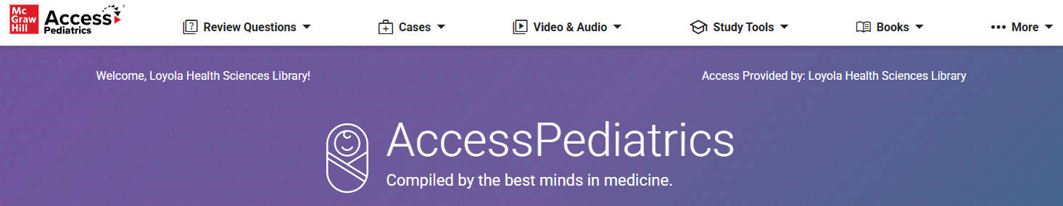
Suggested Textbooks
Pediatrics for Medical Students – Bernstein & Shelov
Blueprints in Pediatrics - Marino
Nelson Textbook of Pediatrics
AccessPediatrics | McGraw Hill Medical

Slide 4
Internet Education Resources
COMSEP Curriculum
  https://www.comsep.org/accordions/curriculum-competencies-and-objectives/
  CLIPP Cases (Computer Assisted Learning in Pediatrics)
    http://www.meduapp.com/
COMSEP Pediatric Physical Exam Video
  www.comsep.org → Educational Resources → Multimedia Teaching Tools → Pediatric Physical Examination (Multimedia Teaching Resources)
Bright Futures http://brightfutures.aap.org/index.html
Pediatrics in Review http://www.pedsinreview.org

Slide 5
Pediatric Resident Sakai Page
https://sakai.luc.edu/portal/
Sakai Login: LUMCpedsclerkship@gmail.com (including the @gmail)
Password: PedsClerkshipLUMC
Newborn Nursery Page
Acutes Page (Outpatient Pediatrics)
Inpatient

Slide 6
Loyola Pediatrics Website
Pediatrics Clerkship Page on LUMEN & Sakai
  Clerkship schedules
  Preceptor evaluations of students
  Goals & objectives
  Lecture handouts
  Key Pediatrics in Review articles

Slide 7
Aquifer CLIPP Cases
  CLIPP Cases (Computer Assisted Learning in Pediatrics) (www.meduapp.com/)
  Must complete all 32 cases by Friday of week 6

Slide 8
Dr. Shahid Pediatric Educational Cases
CRASSH Course in Pediatrics
  Clinical Reasoning & Analytical Skills with Shahid
Several CRASSH cases working through a differential diagnosis
Dr. Shahid Medical Education - YouTube

Slide 9
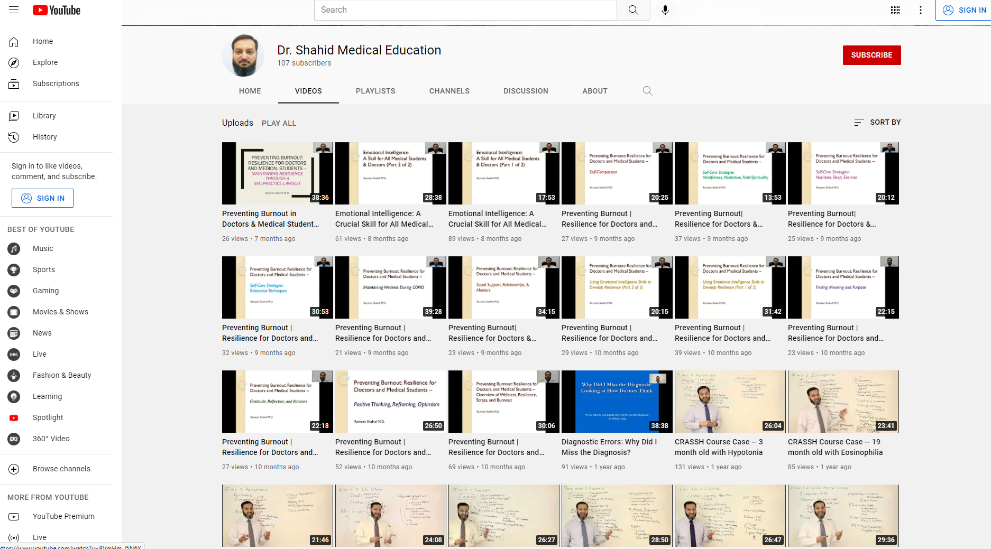

Slide 10
Operation Homefront/Housecall
Operation Homefront/Housecall -- online from below website instead https://www.operationhousecall.com/families-speak/
1-page summary essay/reflection of what you learned from above website

Slide 11
Friday Afternoon Lectures/Quizzes
Required to attend in person
Must go to clinical site in the morning
Be on time for first lecture (12pm or 1pm)

Slide 12
Quizzes
Mystery case presentation every Friday
Create problem list, differential diagnosis, order lab tests. Show us your thought process!
Grading is NOT based on getting final diagnosis. We look at your thought process in creating a BROAD differential diagnosis
Debriefing/learning session
Each quiz is 1% of grade, so total 3% of final grade

Slide 13
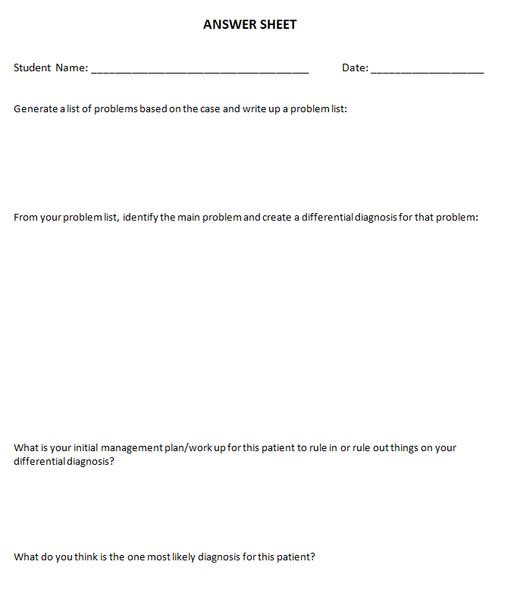

Slide 14
Practice Exam
Practice Exam on Sakai
  During week 3 of the rotation
  Due by 4pm on Friday of week 3
  Open Notes, in Sakai
  20 questions in 30 minutes
  2% of your overall final grade. Get full 2 points for getting >50% correct; get 1 point for >25% correct; and 0 point for <25%

Slide 15
OSCE
In-person/virtual OSCE
Week 5 of the clerkship
Must attend clinical site the morning of OSCE
14% of your grade
3 stations using standardized patients, simulation, models
  Heart (CLIPP 18)
    Standardized patient (mother) after you examine baby (simulated)
  Lungs (CLIPP 12, 13)
    SIM baby/Video
  Ears (CLIPP 14)
    Ear model/Video

Slide 16
Clerkship Assignments
Friday afternoon lecture series with quiz and case discussion, other lectures
All 32 CLIPP cases
Practice Exam on Sakai due 4pm Friday of week 3
Operation Homefront/Housecall reflection essay – 1 page
EBM/Critically Appraised Topic worksheet
OSCE in week 5 of rotation
Clinical Assignments (2 H&P’s, Nursery forms, Patient Log)
NBME Final Exam on last Friday week 6 (need 62% to pass)

Slide 17
Clinical Overview (6-week rotation)
2 week Ambulatory (Outpatient) Pediatrics
2 week Pediatric Inpatient Ward
1 week Nursery
1 week Elective
  Pediatric Emergency Department (nights shifts)
  Night Ward Shifts
  Specialty Week (ID, Card, Hem/Onc)
  Extra week of Outpatient
  Extra week of Inpatient

Slide 18
Inpatient Responsibilities
Ward
  “Read around patients” (beyond the text) and be the expert on them!
  Share with the team (formal and informal)
  Read around and see other interesting patients on your team.
  Work up new patients whenever you can, and help the team take care of all the teams’ patients.
  Pre-round before Morning Report/Grand Rounds (or before rounds on the weekends)
  Write admit notes and daily progress notes

Slide 19
Inpatient Responsibilities: Loyola
Assigned to one of the two teams
Arrive for sign-out at 6am
Pre-round 6am to 8am
M – F rounds with attending at 8am or 9am
Resident Noon Conference 12pm
Hem/onc rounds 1pm
Sign out at 6pm
  1 student from each team may be able to leave early (discretion of senior resident)
Topic presentation(s) on rounds
Weekends: You must work 1 weekend day each weekend
  6am to 2pm (Unless SSOM holiday or after exam)

Slide 20
Inpatient Responsibilities: SAMC & La Rabida
St. Alexius:
  Arrive to pre-round by 7 (or earlier if you need more time). Rounds usually start at 9
  Weekends: You must round on 1 weekend day each weekend (on hold for now)
    Unless SSOM holiday or after exam
La Rabida:
  Sign-out at 7, rounds at 8. Get there early enough to prepare for rounds!
  Paired with resident from University of Chicago
  Weekends: You must round on 1 weekend day each weekend
    Unless SSOM holiday or after exam

Slide 21
Loyola Night Ward
Same expectations as ward
Shift is from 6pm – 12midnight
Arrive at 6pm for sign out from day team
Take new admissions and present to your senior resident and intern
Attend required Friday teaching sessions
No shift night before PCM day
*Evaluation completed by senior resident and/or intern with input from attending

Slide 22
Pediatric Emergency Room
1 week rotation (5-6 shifts)
Arrive at 10p and work until 6a
No shift night before PCM day
Assess patients and present to the senior resident
  Present patient to attending ER doctor together
Complete 1 eval for each night you work by senior peds resident
  If you work with 1 resident for multiple nights he or she may fill out 1 form if desired
    Indicated # nights on evaluation
  Evals will be weighted and averaged to create your grade

Slide 23
Ambulatory Responsibilities
See a variety of patients – well child and sick visits
  Practice otoscopy!
    This is a specific skill on your outpatient evaluation
Read about your patient’s problems and share new knowledge with your preceptors.
Can be fast-paced – learn to think on your feet and synthesize information quickly.
No weekend responsibilities!

Slide 24
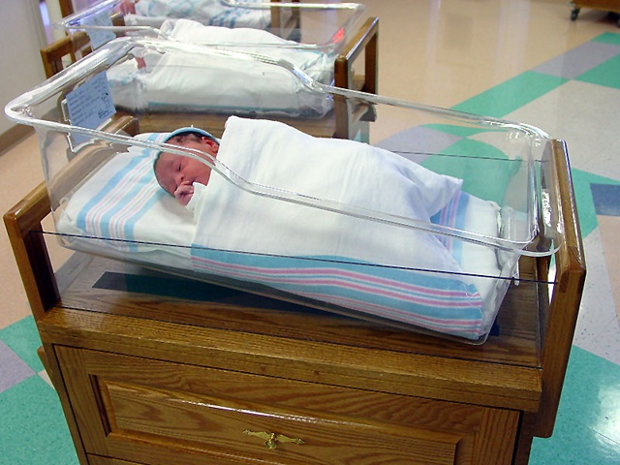
Nursery Responsibilities
  Daily attending rounds
  Pre-round before
  Examine as many babies as possible everyday
  Talk with their families at bedside.
  Attend high risk deliveries
  Evals: observed physical exam, discharge rounds

Slide 25
Loyola Nursery
  Neonatology exposure
    Didactics by neonatologists and/or senior residents around 2pm M-Th
  1 student should stay late daily with intern
  Round one weekend morning – divide among the team.
  Arrive by 6am for sign out on weekdays
    Weekend timing varies based on attending schedule
    You must round on 1 weekend day (Unless SSOM holiday or after exam)

Slide 26
St Alexius Nursery
Arrive at 7 to pre-round
Nursery rounds: 8-10
NICU rounds: 10-12
Attend deliveries with NP and neonatal teams
Lectures in afternoons
NO WEEKENDS!

Slide 27
St. Anthony's
All parts of clerkship are there
3 weeks of inpatient
2 weeks of clinic
1 week of nursery
Weekends – One weekend day each weekend
Dr. Shilpa Singh and Dr. Huda Adam: inpatient evaluation
Dr. Stamboliu and/or Dr. Turaka: nursery evaluation
Dr. Irfan and/or Dr. Al-Dallal: outpatient evaluation

Slide 28
Teaching Conferences
Pediatric Resident Noon Conference
  12pm M, W, Th, F
Pediatric Weekly Grand Rounds
  8am every Tuesday

Slide 29
Teaching Conferences
Pediatric Weekly Schedule (for Loyola-based IP, OP, NBN students)
  Noon Conference (12PM) – M, W, Th, F
  Grand Rounds (8AM) – Tuesdays

Slide 30
Teaching Conferences
St. Alexius, St. Anthony's and La Rabida have their conferences, so you do not attend Loyola residency conferences/Grand Rounds
Do not attend if on week of night ward and night ED shifts

Slide 31
Clinical Assignments
1. History and Physical Case Checking (inpatient)
  Two very complete H&P presented orally and write up formally reviewed by your resident and/or attending. Must be turned in! (1 H&P per week of inpatient)
  You should write H&Ps and daily notes on all patients you work up, even after you’ve turned in your H&P
2. Directly Observed Newborn Exam (newborn nursery)
  Head-to-Toe Physical Exam reviewed and critiqued (checklist) by your Newborn Nursery attending
3. Newborn communication checklist from rounds with parents (newborn nursery)
* UPLOAD to Sakai

Slide 32
Clinical Assignments
Patient logs – (On MyLumen) –
Yellow cards can be used to track daily tallies, but you must log patients online at least weekly so I can ensure that you’re having adequate exposure to pts.
  CLIPP cases count as “simulation” patients
  If you do not log patients in by 2 weeks after the end of the clerkship or turn in your signed printouts, your Professionalism Competency will be marked “With concerns”.

Slide 33
Clerkship Assignments
Friday afternoon lecture series with quiz and case discussion, other lectures
All 32 CLIPP cases
Practice Exam on Sakai due 4pm Friday of week 3
Operation Homefront/Housecall reflection essay – 1 page
EBM/Critically Appraised Topic worksheet
OSCE in Friday week 5 of rotation
Clinical Assignments (2 H&P’s, Nursery forms, Patient Log)
NBME Final Exam on last Friday week 6 (need 62% to pass)

Slide 34
Feedback
Please ask for specific feedback from your preceptors
  Attendings, residents, interns
Be proactive!

Slide 35
Mid-Clerkship Feedback
Mid-Clerkship Feedback form on Sakai
Meet with any of your preceptors from the first 3 weeks and review your form with them (signatures on form)
Upload completed form to Sakai
Due by 4pm on 3rd Friday of the rotation
Dr. Shahid/Qureshi will review and email you
  Number of CLIPP cases completed so far
  Summary of your logged patients so far
  Scores for quizzes so far
  Score for Practice Exam

Slide 36
Evaluations
You are responsible for requesting forms from preceptor
Clinical Evaluation forms online through myLumen
  sign onto myLumen
  click on Clinical Performance Review (left side menu)
  Request Evaluation Link
Only Pediatric attendings/residents are allowed to evaluate student – no rotating or outside residents with exception of students assigned to Non-Loyola clinics
  ER Rotation: Inform Natalie of any EM residents that you worked with and she will send them an eval form

Slide 37
Outpatient Clinic
Request an evaluation from main preceptor for the clinic you were at (except LOC and Elmhurst/Oak Park)
Do not request evaluations from every preceptor
Main preceptor completes evaluation reflecting input from others you worked with
Site preceptors are listed on the Preceptor List you get at the beginning of the clerkship and on clerkship website
Inpatient Ward
Loyola – request evaluation from the attending (resident as extra eval) you work with for each week of ward
St. Alexius – request evaluation from Dr. Stephen Pichler, the site preceptor for inpatient
La Rabida – the attending you worked with
Nursery
Loyola – request evaluation from the attending (resident as extra eval) that you work with for each week of nursery
St. Alexius – request evaluation from Anne Drahos, the site preceptor Nursery Rotation
ER Nights
Request an evaluation from each resident you work with each night.
All evaluations for the ER week are averaged for final score.
Night Ward Loyola
Request evaluation from the resident that was with you for that week

Slide 38
Evaluations
Preceptors have up to 3 weeks after the clerkship ends to submit evaluations.
If you have a question about any evaluation, email clerkship director and director will talk with your preceptor
Grades are finalized to the Registrar’s Office no later than 4 weeks after the end of clerkship.

Slide 39
Evaluations
Scoring System
1 = 60%
2 = 70%
3 = 80%
4 = 90%
5 = 100%

Slide 40
Grading Policy 2025-26
Subjective Evaluations 36%
  Each week 6%
OSCE 14%
Quizzes (1% each) 3%
Practice Exam 2%
Clerkship Assignments 5%
  Graded H&P x 2 (2%)
  EBM CAT Form (1%)
  Nursery checklist, mommy rounds, Operation Homefront reflection, 32 required CLIPP cases, Develop Milestones Module (2%)
Final online exam 40%

Slide 41
Final Grade
Honors: >1 standard deviation (SD) above the mean
High Pass: 0.25 SD below mean to 1 SD above mean
Pass: 69.9%
  Example: class mean if 80, standard deviation 8
    H: 88+
    HP: 78-87
    P: 69.9%
Must pass clinical (60%), NBME exam (62%) and OSCE (60%)
  Remediation offered as needed

Slide 42
Final Grade
Pass the Clerkship Overall: 69.9%
At the end of the year, I analyze all data and your grade may change
End of year curved 30%/40%/30% for Honors/High Pass/Pass
  Only could go up, NEVER down ☺

Slide 43
NBME Exam
Need 62% to pass
Less than 62% will get does not meet expectation on Medical Knowledge (MK) Competency
62% -- 65% will get meets with concern on MK Competency
66% or higher will get meets MK Competency

Slide 44
Student Feedback
End of Clerkship On-Line System
  Must be completed within 2 weeks of clerkship completion, or your Professionalism Competency will be marked “With Concerns”
Real Time Feedback

Slide 45
Absences
Notify your preceptor and Dr. Shahid/Natalie Hiller if you miss time due to illness.
  Please also “cc” Dean Mendez, Dean Zarco, and Sharee Myricks
  Need documentation for Wellness Center/Student Health for absence and clearance to return
Requirements for making up lost time depend on how many days & what part of the rotation was missed. Will be decided on a case-by-case basis.
Excuses to miss exam due to illness require written note from Wellness Center/Student Health and notification of Dean Mendez’s office.

Slide 46
SMART Goal Worksheet
Complete the worksheet and upload to Sakai by 4pm Friday week 1
Review SMART goal with your preceptor for mid-rotation feedback form

Slide 47
Questions?

