Slide 1
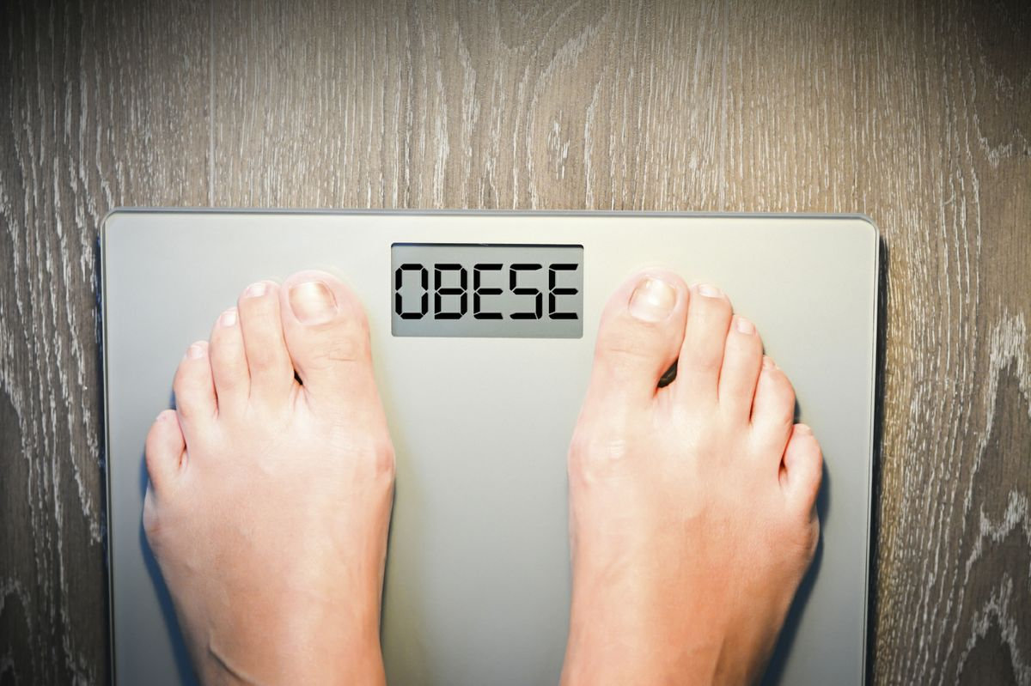
‹#›
OBESITY
An overview of pathophysiology and management

Slide 2


Definition
The disease of obesity is characterized by an excessive accumulation of body fat.
The World Health Organization (W.H.O.) and National and International medical and scientific societies, now recognize obesity as a chronic progressive *disease* resulting from multiple environmental and genetic factors.

Slide 3
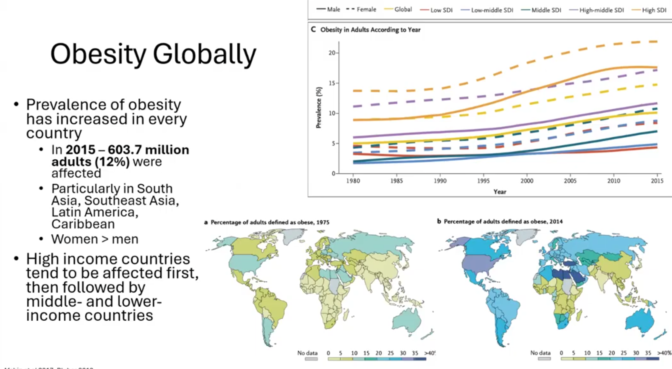
Obesity Globally
Prevalence of obesity has increased in every country
In 2015 - 603.7 million adults (12%) were affected
Particularly in South Asia, Southeast Asia, Latin America, Caribbean
Women > men
High income countries tend to be affected first, then followed by middle- and lower-income countries

Slide 4
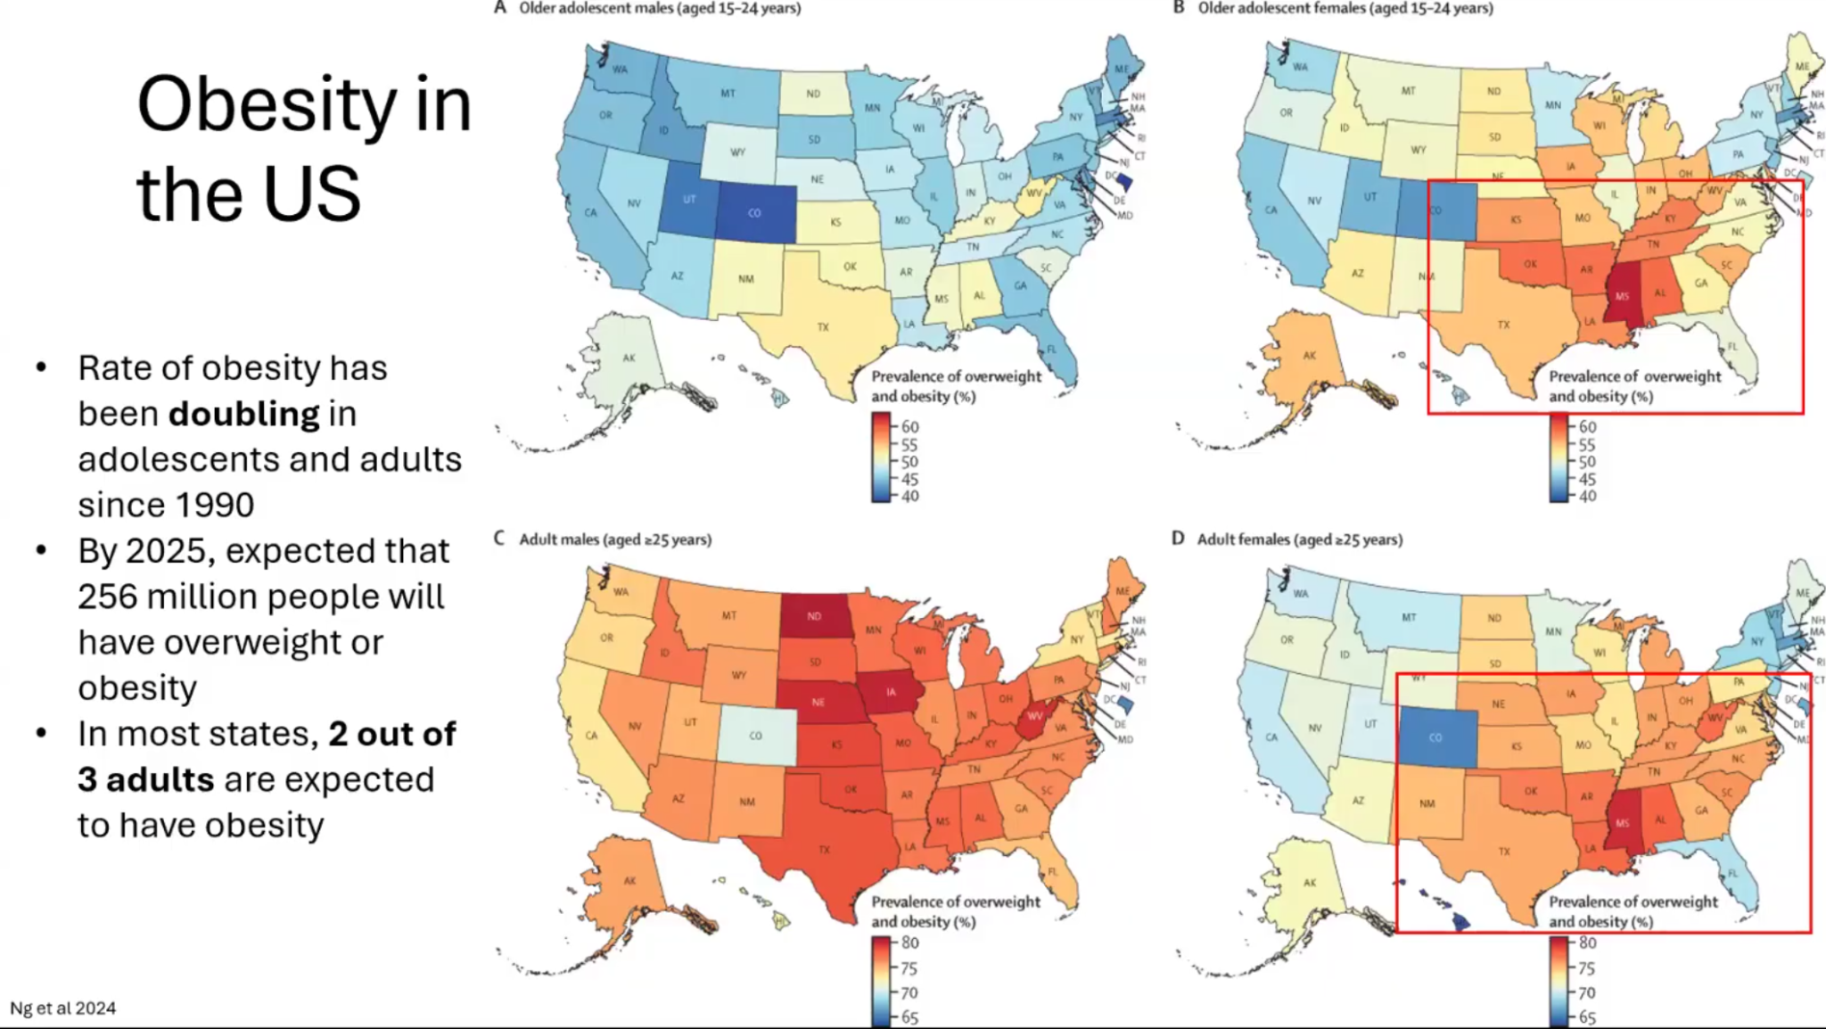
Obesity in the US
A Older adolescent maies (aged 15-24 years)
B Older adolescent females (aged 15-24 years)
Rate of obesity has been **doubling** in adolescents and adults since 1990
By 2025, expected that 256 million people will have overweight or obesity
In most states, **2 out of 3 adults** are expected to have obesity
C Adult males (aged >25 years)
D Adult females (aged >25 years)

Slide 5
Category | BMI Range
Normal Size | 18.9 to 24.9
Overweight | 25 to 29.9
Class I, Obesity | 30 to 34.9
Class II, Serious Obesity | 35 to 39.9
Class III, Severe Obesity | 40 and greater
Body mass index
Formula: weight compared to height kg/m2
Easily obtainable, trackable, inexpensive
Does not tell us the body composition

Slide 6
Pathogenesis of obesity
‹#›
Obesity pathogenesis involves two related but distinct processes
01
02
Sustained positive energy balance (energy intake > energy expenditure)
Resetting of the body weight “set point” at an increased value

Slide 7

‹#›
Is obesity just related to calories in vs out?

Slide 8






Multifactorial Obesity
Nutrition
Physical activity
Personal history
Sleep / mental health
Life changes (aging, pregnancy, menopause)
Medication side effects

Slide 9
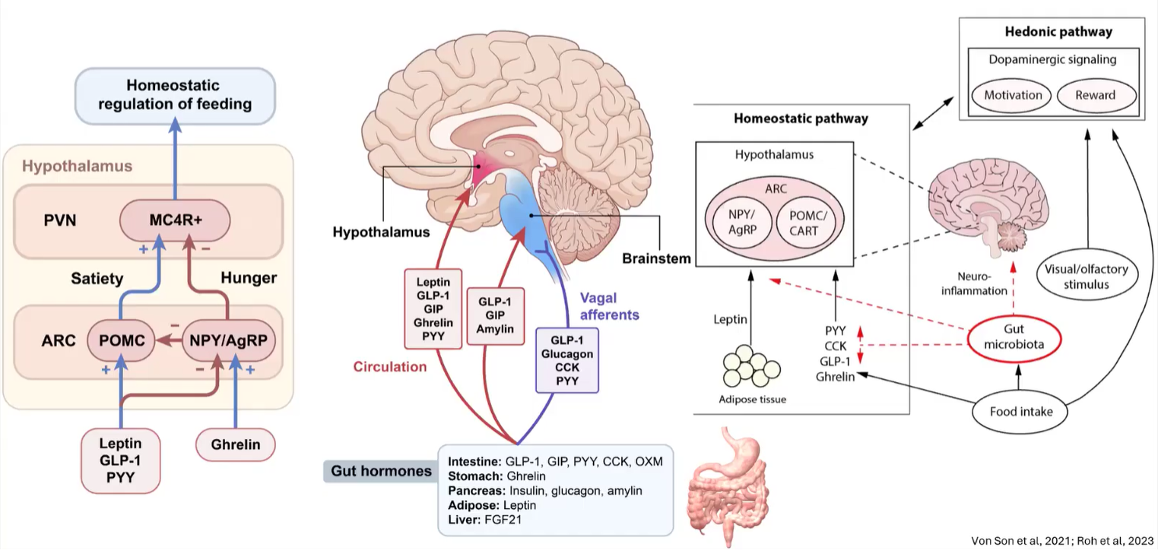
Obesity and Appetite Regulation

Slide 10
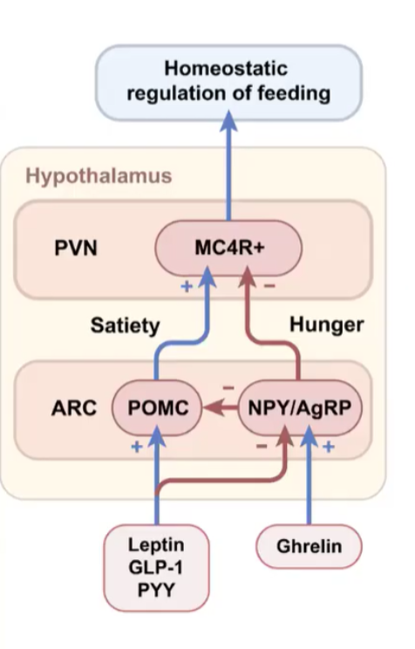
Homeostatic pathway
Two pathways: POMC/CART pathway (anorexigenic)
NPY/AgRP pathway (orexigenic)
They have a antagonistic association
In the hunger state, ghrelin stimulates NPY - AgRP which causes appetite to increase and energy expenditure to decrease, thereby promoting increased adipose tissue storage.
Meal-terminating hormones synthesized in the gastrointestinal tract ( GLP 1, PYY) hormones made in the adipose tissue and pancreas ( adiponectin and leptin), nutrients, and anti-obesity medications activate POMC/CART pathway which acts by increasing satiety, decreasing appetite, and increasing energy expenditure, thereby promoting weight loss.

Slide 11
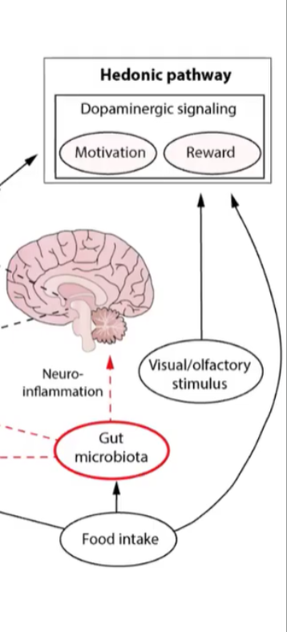
Hedonic pathway
This system can induce hunger without a caloric deficit and is influenced by emotions related to eating and hunger.
Several neurologic areas of stimulation, with external inputs affecting these structures differently.
Limbic system: primarily driven by dopamine and mediates cravings, rewards, compulsions, and food addiction. similar to what would be seen with other substance addictions.
Emotion/Memories:
Amygdala: This area responds to food cues (advertisements, visuals, etc.). This is where commercials and advertisements may affect our eating patterns.
Hippocampus: Memories or prior experiences activate this area (i.e., the smell of a dessert reminds you of a family celebration). This can also have a negative impact, for example, if you vomit after eating a particular food, you may develop a food aversion.
Pre-frontal cortex: This area involves impulse control, spontaneity, planning, and decision-making and influences personality. People who enjoy spontaneity or are considered more impulsive may be more likely to eat out or indulge spur of the moment without considering the consequences. In contrast, planners and rule-followers may be more inclined to benefit from tracking calories and show more restraint to meet their goals.

Slide 12
Benefits of weight loss
0%
5%
10%
15%
20%
25%
30%
35%
T2D prevention
Physical function
T2D glycemia
HTN
Cardiometabolic
Biomechanical
Semaglutide 2.4 mg
Sleep apnea
T2D remission
NASH

Slide 13
‹#›
Approaching a patient with obesity

Slide 14




Weight specific history
Review patient’s current, highest and lowest adult weight.
Determine if the weight gain began in childhood.
Review of any specific periods of weight gain. Any secondary causes of obesity?
Review of any weight promoting medications

Slide 15
Weight promoting medications
Category | Medications
Antidepressants, anti-anxiety, mood stabilizers:
Selective serotonin reuptake inhibitors (SSRIs): | Paxil, Zoloft, Celexa, Prozac
Older antidepressants: | Amitriptyline, Imipramine, Nortriptyline, Trazodone, Monoamine oxidase inhibitors (MAOIs)
Lithium, Benzodiazepines
Antipsychotics | Olanzapine, Clozapine, Risperidone, Quetiapine, Aripiprazole, Haloperidol
Diabetes medications
Insulin | Both short- and long-acting
Sulfonylureas | Glimepiride, Glipizide, Glyburide
Thiazolidinedione | Pioglitazone
Other | Nateglinide, Repaglinide
Steroid hormones
Synthetic progestins | Medroxyprogesterone, Norethindrone, Levonorgestrel
Contd…

Slide 16
Category | Medications
Contraceptives | Oral contraceptive pills, Nexplanon
Corticosteroids | Prednisone, Methylprednisolone, Prednisolone
Chemotherapy | Tamoxifen, Arimidex
Anticonvulsants, anti-migraine, neuropathic pain | Gabapentin, Pregabalin, Valproic acid, Carbamazepine, Divalproex
Opioids | All opioids may decreased metabolic rate and exercise tolerance
Anti-hypertensive
Beta-blockers | Atenolol, Metoprolol, Propranolol, Acebutolol
Alpha-blockers | Clonidine
Calcium channel blockers | Nisoldipine
Antihistamines | Diphenhydramine, Fexofenadine, Cetirizine, Ranitidine, Azelastine
Other
Hypnotics | Remeron, Zolpidem, Doxepin
Anti-retroviral

Slide 17

Dietary history
Review of patients current dietary patterns - skipping breakfast? one large meal a day? Eating too frequently? Home meals vs eating out? Grocery shopping (to assess if there is lack of control over their own intake?)
24 hr dietary recall
(to understand patient’s dietary choices)
Important to note frequency and quantity of both liquid/caloric drinks and alcohol

Slide 18

Psychiatric history
‹#›
Review of related psychiatric history including anxiety, depression that can translated to disordered eating.
Binge eating disorder
Binge Purge disorder
Night eating syndrome

Slide 19
Binge eating disorder
Eating an amount of food in a discrete period of time ( eg - 2 hrs) that is definitely larger most people would eat in a similar period of time under similar circumstances
01
02
Episodes occur on average once a week for 3 months

Slide 20
Night eating syndrome
Night eating syndrome: Recurrent episodes of night eating defined as eating during nocturnal awakenings from sleep or eating excessively after evening meal twice a week.

Slide 21






‹#›
Lifestyle history
Review of patients lifestyle
Sedentary lifestyle
Exercise or no? Barriers to exercise ?
Life events - Pregnancy, post partum
Weight retention 1 year postpartum can contribute to weight retention 15 years later

Slide 22





‹#›
Weight loss history
Previous attempts at weight loss?
Did it work?
Weight cycling?
Previous challenges faced both in losing weight and maintaining weight

Slide 23

‹#›
Sleep history
Review sleep patterns
Poor sleep is associated with increased appetite and reduced energy expenditure

Slide 24

Past medical history
Assess weight related comorbidities
Sleep apnea
NAFLD
Type 2 Diabetes
Hyperlipidemia
Hypertension

Slide 25
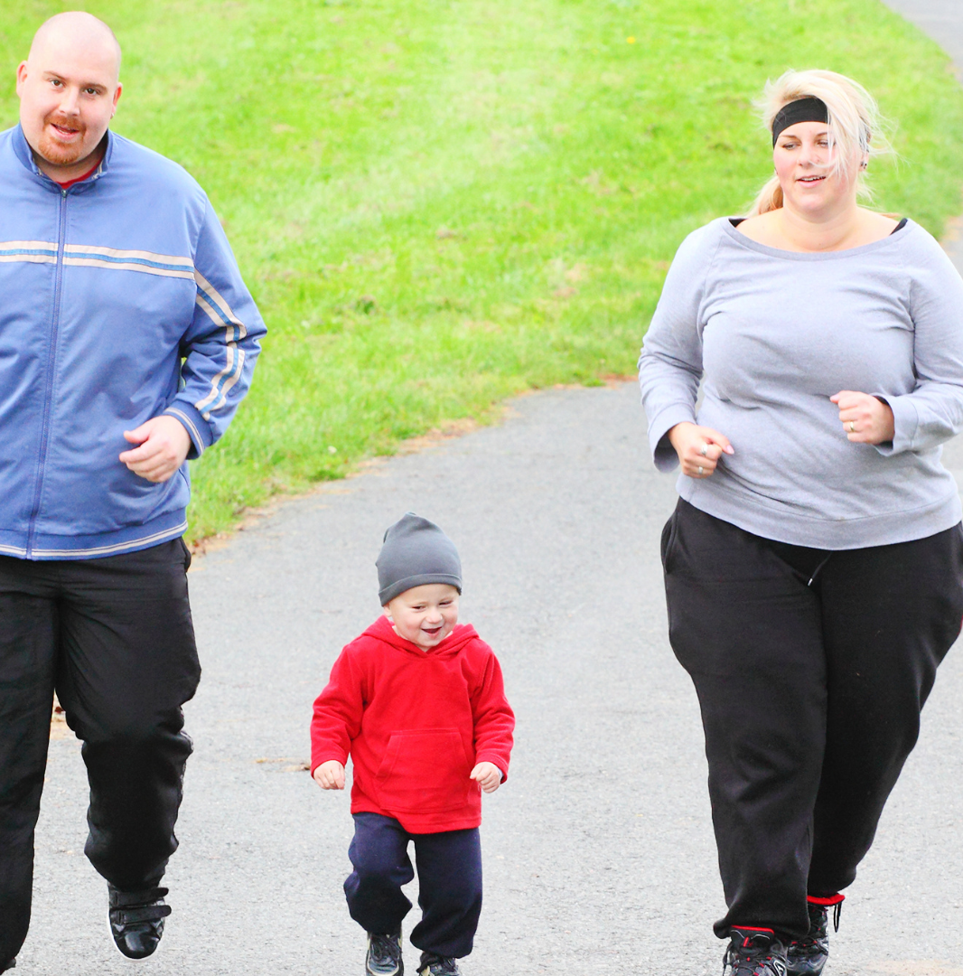
Family history and Social history
Family history of overweight or obesity.
Assess for social risk factors including a sedentary job and lower socioeconomic status.

Slide 26
Physical Exam
Height
Weight
Waist circumference
Accurate BP cuff
Specific - atrophic skin, purple striae, moon facies (suspicious for Cushing)
Acanthosis nigricans (indicating insulin resistance)
Hirsutism (suspicious for PCOS)

Slide 27

Laboratory evaluation
Fasting plasma glucose, Hemoglobin A1c
Fasting lipid panel
1
2
CBC
5
3
TSH and free thyroxine
4
CMP

Slide 28
Evaluation of weight related comorbidities
Pulmonary - Evaluate for OSA , obesity hypoventilation syndrome
STOP
Do you SNORE loudly (louder than talking or loud enough to be heard through closed doors)? | Yes | No
Do you often feel TIRED, fatigued, or sleepy during daytime? | Yes | No
Has anyone OBSERVED you stop breathing during your sleep? | Yes | No
Do you have or are you being treated for high blood PRESSURE? | Yes | No
BANG
BMI more than 35kg/m2? | Yes | No
AGE over 50 years old? | Yes | No
NECK circumference > 16 inches (40cm)? | Yes | No
GENDER: Male? | Yes | No
TOTAL SCORE
High risk of OSA: Yes 5 - 8
Intermediate risk of OSA: Yes 3 - 4
Low risk of OSA: Yes 0 - 2
Notes:
Today, we'll cover five main objectives:
First, defining and understanding what a maxillary midline diastema is.
Second, reviewing its prevalence and developmental causes.
Third, diving into the multifactorial etiology and possible management strategies.
Fourth, looking at treatment options including interdisciplinary collaboration.
And finally, discussing long-term retention strategies.

Slide 29
Epworth Sleepiness Scale
How likely are you to doze off or fall asleep in the following situations?
Use the following scale to choose the most appropriate number:
0 No Chance | 1 Slight chance | 2 Moderate chance | 3 High chance
Watching television |  |  | 0 | 1 | 2 | 3
Sitting inactive, in a public space |  |  | 0 | 1 | 2 | 3
Lying down to rest in the afternoon when circumstances permit |  |  | 0 | 1 | 2 | 3
Sitting and talking to someone |  |  | 0 | 1 | 2 | 3
Sitting quietly after a lunch without alcohol |  |  | 0 | 1 | 2 | 3
As a passenger in car for an hour without a break |  |  | 0 | 1 | 2 | 3
In a car, while stopped for a few minutes in traffic |  |  | 0 | 1 | 2 | 3
Watching television |  |  | 0 | 1 | 2 | 3
TOTAL SCORE

Slide 30
Evaluation of weight related comorbidities
Cardiovascular - Obesity independent risk factor for coronary heart disease
Gastrointestinal - NAFLD , reflux esophagitis
Orthopedic - OA is common in patients with obesity
Metabolic - Prediabetes, Type 2 Diabetes, Hyperlipidemia
Reproductive - Women have anovulation, infertility, PCOS, pelvic stress incontinence
Cutaneous - Intertrigo is common in patients with obesity. Counsel on good hygiene
Psychiatric - Depression most commonly seen
Other disorders precluding use of certain medications
Notes:
Today, we'll cover five main objectives:
First, defining and understanding what a maxillary midline diastema is.
Second, reviewing its prevalence and developmental causes.
Third, diving into the multifactorial etiology and possible management strategies.
Fourth, looking at treatment options including interdisciplinary collaboration.
And finally, discussing long-term retention strategies.

Slide 31



Management
Assessment of motivation
Realistic goal setting: Not necessary to reach to ideal body weight, health benefits achieved with 5-10% loss of total body weight
Rate of weight loss : 1-2 lb/week over a course of 6 months. ( rate of weight loss is also not very important)

Slide 32
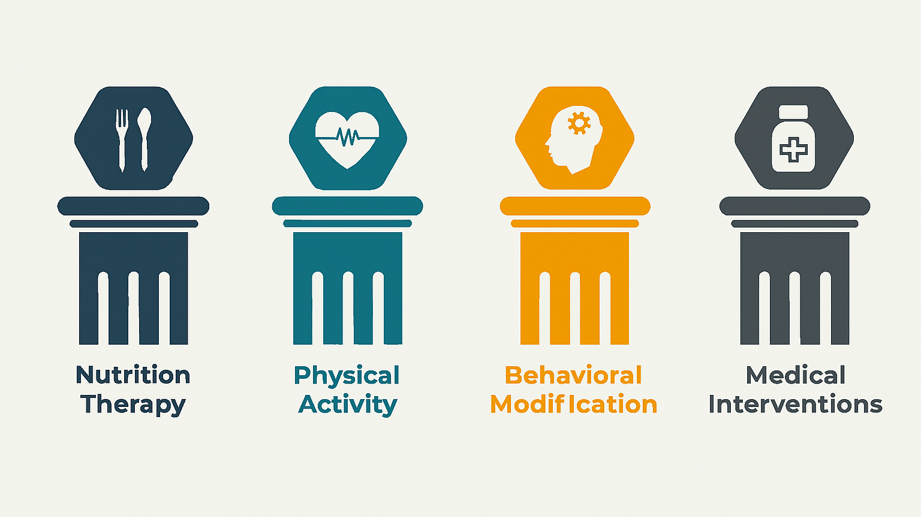
Notes:
Today, we'll cover five main objectives:
First, defining and understanding what a maxillary midline diastema is.
Second, reviewing its prevalence and developmental causes.
Third, diving into the multifactorial etiology and possible management strategies.
Fourth, looking at treatment options including interdisciplinary collaboration.
And finally, discussing long-term retention strategies.

Slide 33

‹#›
Nutrition Therapy
Energy deficit is required to achieve weight loss
Multiple approaches
Specific calorie target : 1200- 1500 kcal/day, females
1500- 1800 kcal/day, males
Estimate individual calorie requirement and decrease it by 500 kcal/day
Lower calorie intake by eliminating one or more particular food groups

Slide 34

Different diets
Low calorie diet ( 1200-1800 kcal /day)
Very low-calorie diet ( < 800 kcal)
Low carbohydrate diet ( 50 - 100 g/day)
Very low carbohydrate diet ( < 50gms/day )
Low fat diet ( < 30% calories from fat)
Low glycemic index diet ( GI< 55)

Slide 35



Intermittent fasting
Periods of restricted eating (fasting) is alternated with periods of eating
Several variations - fasting for multiple days to Time restricted feeding where eating window is 8 hours a day for several weeks

Slide 36
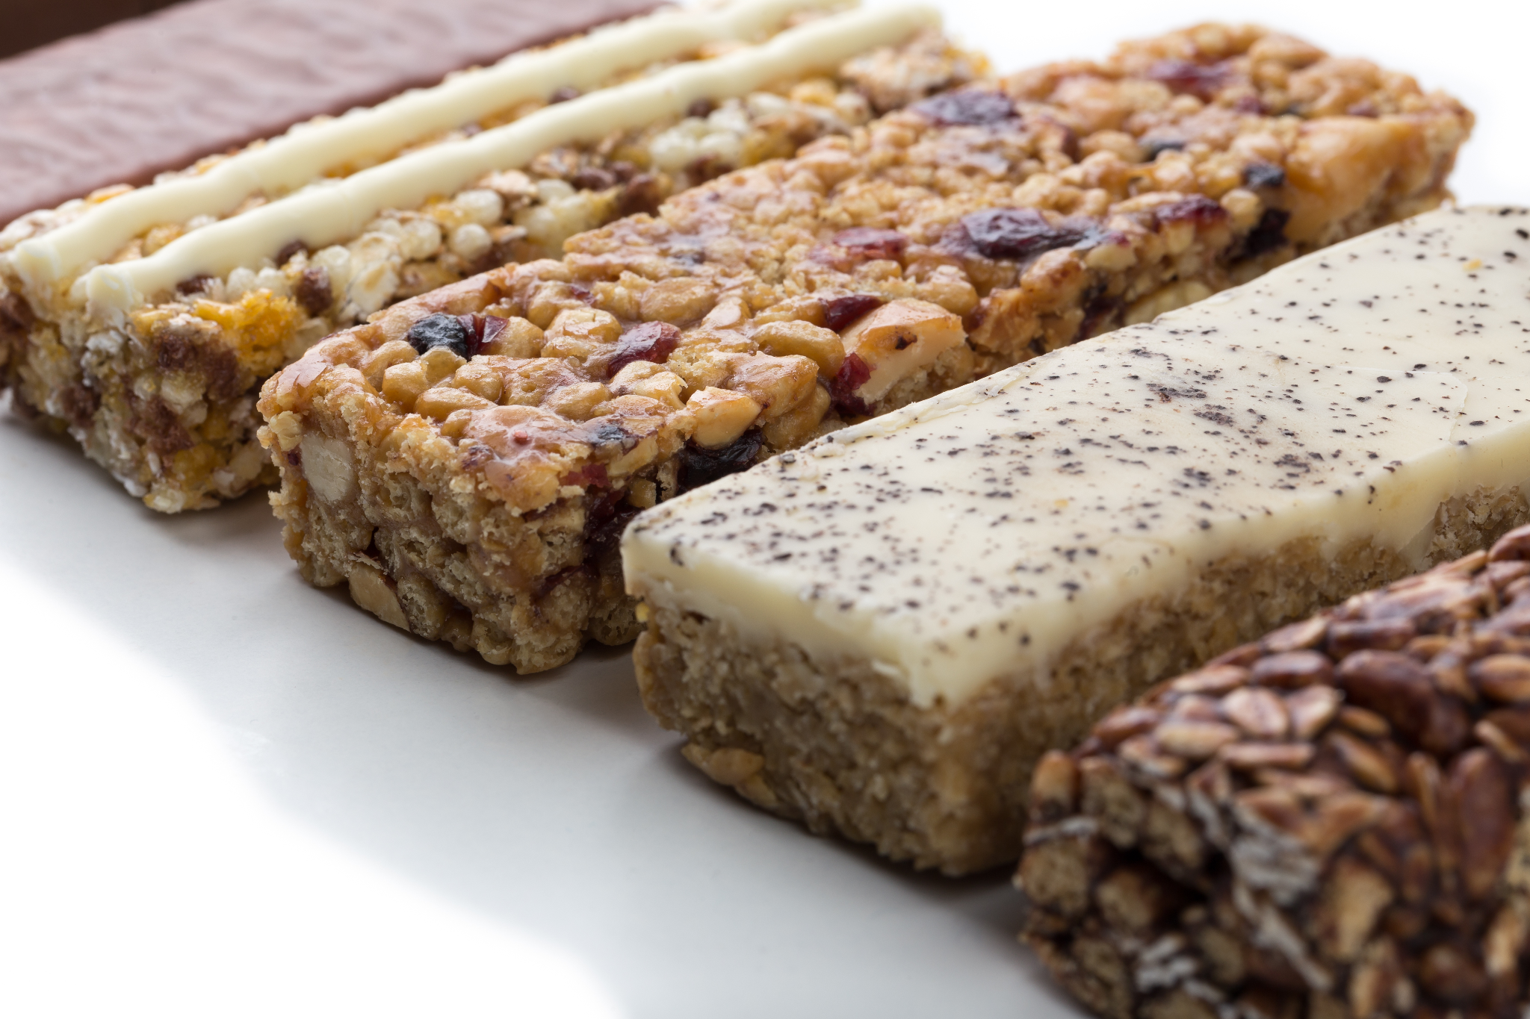
Meal replacement
Functional foods in the form of drink or bar
Helpful in challenging situations where would otherwise eat unhealthy food

Slide 37

Best diet?
The best nutritional intervention is a plan that is evidence based, quantitatively sound , qualitatively appropriate and one the patient prefers and is therefore more likely to adhere to over a lifetime

Slide 38




Mediterranean diet
Olive oil is the main source of fat
High intake of vegetables, legumes, whole grains, nuts and seeds
Moderate intake of seafood, poultry, eggs, dairy products
Considered to be the healthiest dietary pattern available to reduce the prevalence of overweight and obesity

Slide 39
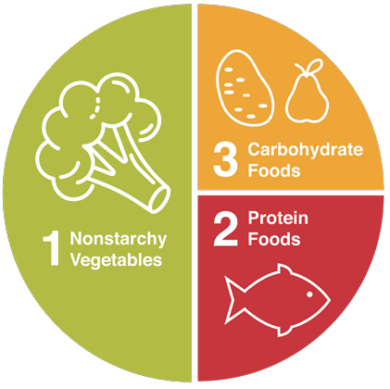
Simpler tips to counsel patients
Plate method
Fill 1/2 of the plate with non-starchy vegetables
Non starchy vegetables are low in carbohydrates. One serving amounts to one cup raw veggies, such as a salad greens or 1/2 cup cooked, such as broccoli. You can have as many non-starchy vegetables as you like, but make sure at least half of your plate is filled with things like green salad, broccoli, or asparagus.
Fill 1/4 of the plate with grains, starchy vegetables, or beans and lentils
Choose whole grains such as brown rice or quinoa which are rich in vitamins, minerals, and fiber. Beans and lentils contain both starch and protein with good amounts of fiber.
Fill 1/4 of the plate with Protein
This section includes meat and other protein sources, such as eggs and fish. Look for lean cuts of meat and low-fat cheeses. 1/4 of the plate is equivalent to a 3 oz cooked portion (about the size of a deck of cards or the palm of your hand).

Slide 40
Simpler tips to counsel patients
Avoid skipping meals
Avoid liquid calories (regular soda, juice, coffee with cream) substitute with water, sparkling water, non caloric alternatives)
1
5
2
Replace all white bread with whole wheat/whole grain alternatives
Snack on fruits, low fat dairy (yogurt , cottage cheese)
4
3
Avoid high fat, high calorie, high carbohydrate snacks ( cookies, pastries, cakes)

Slide 41
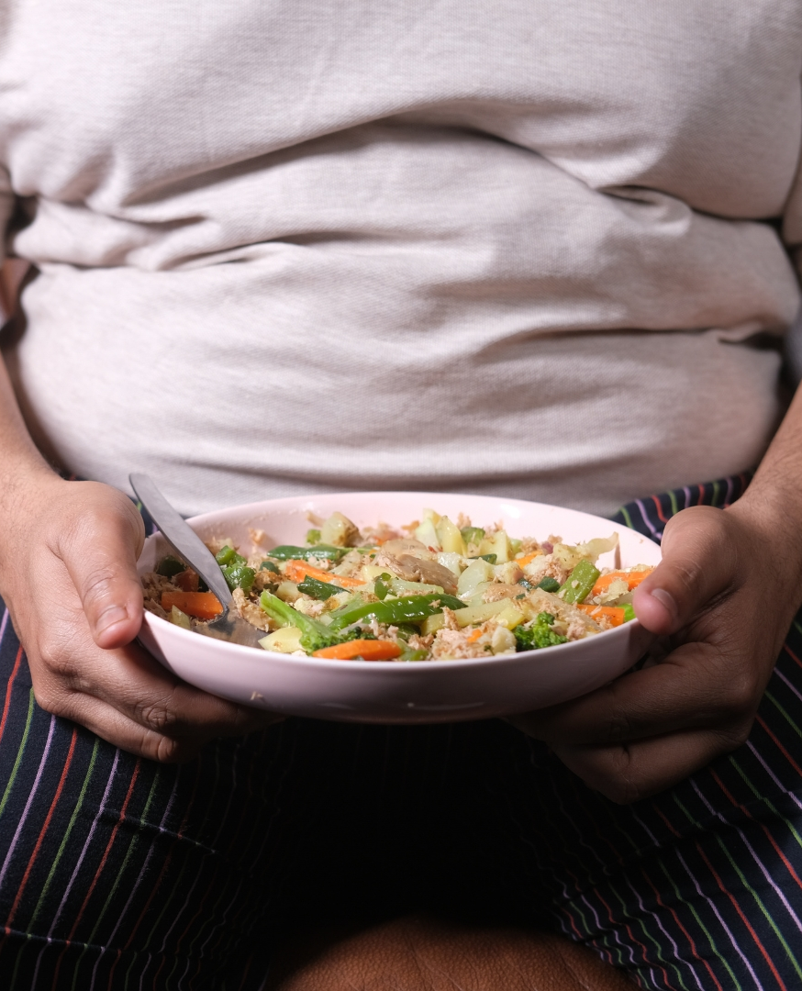

Behavioral modification
Critical component is successfully treating obesity
Can be used to support any dietary intervention

Slide 42

Various components of behavioral treatment program
Self monitoring of dietary intake
30 percent of daily calorie intake is under reported
Behavioral treatment focusing on tracking calories, reading food labels, using appropriate measuring tools

Slide 43

Behavioral modifications
Trigger or stimulus control
Techniques to help control patient’s environment
Ex - keep food out of sight
Limit the number of places where food can be eaten to kitchen or dining table
Refrain from eating while engaging in other activities like watching television, working on computer.
Avoid eating for reasons other than hunger
Avoid frequent snacking

Slide 44
Behavioral modifications
Cognitive restructuring
Identify and establish plan to counteract unhelpful or dysfunctional thinking leading to unhealthy behaviors and actions
Encourage patient to
Acknowledge he/she is capable of positive thoughts and behaviors
Replace unhelpful thoughts and behaviours with more productive ones
Example - May overeat one evening and decide to give up altogether. Teach them to recognize a setback as a temporary lapse and move forward

Slide 45


Behavioral modifications
Problem solving
Techniques for when they encounter barriers that limit their ability to be consistent with healthy diet and exercise plan
Example - patient may travel for work and not have access to their usual planned meals - but with proper education they can create solution to overcome uncertain situation

Slide 46


Behavioral modifications
Relapse prevention
Particularly focusing on high-risk situations that may create set back (vacation, illness, periods of high stress)
Behavioral therapy focusing on planning for such events either individually or in groups.
Group format provides social support and individuals can help one another develop strategies to overcome barriers around achieving the diet and exercise goals.

Slide 47

Physical activity
At least 150 minutes of moderate intensity aerobic activity per week or 75 minutes of vigorous intensity aerobic exercise
Resistance training - 2 days a week
Exercise prescription
FITTE
Frequency
Intensity
Time spent
Type
Enjoyment level

Slide 48
Physical activity - Special considerations
Recommend rehabilitation and physical therapy guided activity program
01
02
Unable to walk - seated exercise program
04
03
Aquatic exercises
Arm exercises

Slide 49

Non exercise activity thermogenesis ( NEAT)
Energy expended for everything we do that is not sleeping, eating or exercise.
It ranges from the energy expended walking to work, typing, performing yard work, undertaking agricultural tasks and fidgeting.
Patients with high NEAT tend to lose more weight.
Ex - Taking elevators instead of stairs.

Slide 50

Pharmacological treatment
Candidates who qualify for medical treatment of obesity
BMI > 30
BMI > 27
with one or more weight related comorbidities

Slide 51







Phentermine
Approved: 1959
Side effects: Headaches, high blood pressure, rapid or irregular heart rate, overstimulation, tremor, insomnia, dry mouth
Mechanism of action: Sympathomimetic, epinephrine norepinephrine reuptake inhibitor. Suppresses appetite
Contraindications: History of Cardiovascular disease ( CAD, stroke, arrhythmia, CHF, uncontrolled HTN) , During or within 14 days of use of MAOI, Hyperthyroidism, Glaucoma, Agitated state, Drug use , pregnancy and nursing
Approved for short term use ( 12 weeks)
Efficacy: 5% of body weight
Dosing: 15 mg daily - 37.5 mg daily

Slide 52
Orlistat
Approved: 1999
Side effects: Oily discharge with flatus from the rectum, especially after fatty foods, fecal urgency. May cause malabsorption of fat soluble vitamins ( A, D, E, K)
Mechanism of action: Gastrointestinal lipase inhibitor that impairs digestion of dietary fat
Contraindications: Chronic malabsorption syndrome and cholestasis, pregnancy and nursing
Efficacy: 5% of body weight
Dosing: 60 mg (OTC ),120 mg(prescription) three times daily before meals

Slide 53
Phentermine/Topiramate ER (Qsymia)
Approved: 2012
Titration = 11.25mg/69mg Top dose = 15 mg/92 mg
Mechanism of action: Phentermine - sympathomimetic effects on the hypothalamus suppressing appetite
Side effects: Paresthesia, Dysgeusia, Dizziness, Dry mouth Constipation, disturbance in attention, hypoesthesia
Topiramate - Appetite suppression, satiety enhancement through neurotransmitters
Contraindications: Glaucoma, Hyperthyroidism, Kidney stones, During or within 14 days of taking MOAI, pregnancy and nursing
Efficacy: 8% - 10% of body weight
Dosing: Once daily in the morning 3.75mg/23 mg increase after 14 days to 7.5mg/46 mg

Slide 54
Naltrexone/Bupropion ( Contrave)
Approved: 2014
Dosing : Tablets = 8 mg/90 mg ( Naltrexone HCl/Bupropion HCl extended release)
Week 1= 1 tablet in am, no tablets in pm
Week 2= 1 tablet in am , 1 tablet in pm
Week 3= 2 tablets in am, 1 tablet in pm
Week 4= 2 tablets in am , 2 tablets in pm
Mechanism of action: Bupropion - stimulates hypothalamic POMC neurons reducing food intake and increase energy expenditure
Naltrexone - blocks opioid receptor mediated POMC autoinhibition, augmenting POMC firing in a synergistic manner.
Side effects : Nausea, headaches, constipation, dizziness
Efficacy: 3-6%
Contraindications: Uncontrolled hypertension, seizure disorder, chronic opioid use, during or within 14 days MOAI , contraindicated during pregnancy or nursing

Slide 55
Liraglutide ( Saxenda)
Approved: 2014
Side effects: GI side effects - nausea, abdominal pain, constipation, diarrhea, fatigue
Mechanism of action: Binds and activates the GLP- 1 receptor that is expressed in multiple brain regions that regulate appetite and caloric intake inhibits gastric emptying
Contraindications: MEN2 syndrome, medullary thyroid cancer; h/o pancreatitis
Efficacy: 8- 10 %
Dosing: start with 0.6 mg daily for 1 week; increase by 0.6 mg increments at weekly intervals to target dose of 3 mg daily

Slide 56
Semaglutide ( Wegovy)
Approved: 2021
Side effects: GI side effects - nausea, abdominal pain, constipation, diarrhea, fatigue
Mechanism of action: Binds and activates the GLP- 1 receptor that is expressed in multiple brain regions that regulate appetite and caloric intake, inhibits gastric emptying
Contraindications: MEN2 syndrome, medullary thyroid cancer; h/o pancreatitis
Efficacy: ~15%
Dosing: start with 0.25mg weekly for 4 weeks -> increase dose every 4 weeks from 0.25mg -> 0.5mg weekly -> 1mg weekly -> 1.7mg weekly -> 2.4mg weekly (maintenance dose)

Slide 57
Tirzepatide ( Zepbound)
Approved: 2023
Side effects: GI side effects - nausea, abdominal pain, constipation, diarrhea, fatigue
Mechanism of action: Binds and activates the GLP- 1 receptor and GIP
Contraindications: MEN2 syndrome, medullary thyroid cancer; h/o pancreatitis
Efficacy: ~21%
Dosing: start with 2.5mg weekly for 4 weeks > increase dose every 4 weeks from 2.5mg > 5mg weekly > 7.5mg weekly > 10mg weekly > 12.5mg weekly > 15 mg weekly (maintenance dose)

Slide 58
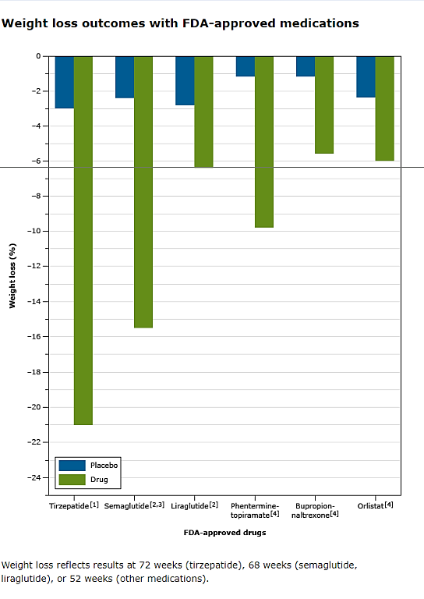
Weight loss outcomes with FDA-approved medications
Weight loss reflects results at 72 weeks (trizepatide), 68 weeks (semaglutide, liraglutide), or 52 weeks (other medications).

Slide 59

Bariatric surgery guidelines
BMI of 35 or more “regardless of presence, absence, or severity of obesity-related conditions”
BMI 30-34.9 and metabolic disease
BMI > 30 who do not achieve substantial or durable weight loss or obesity disease-related improvement using nonsurgical methods

Slide 60
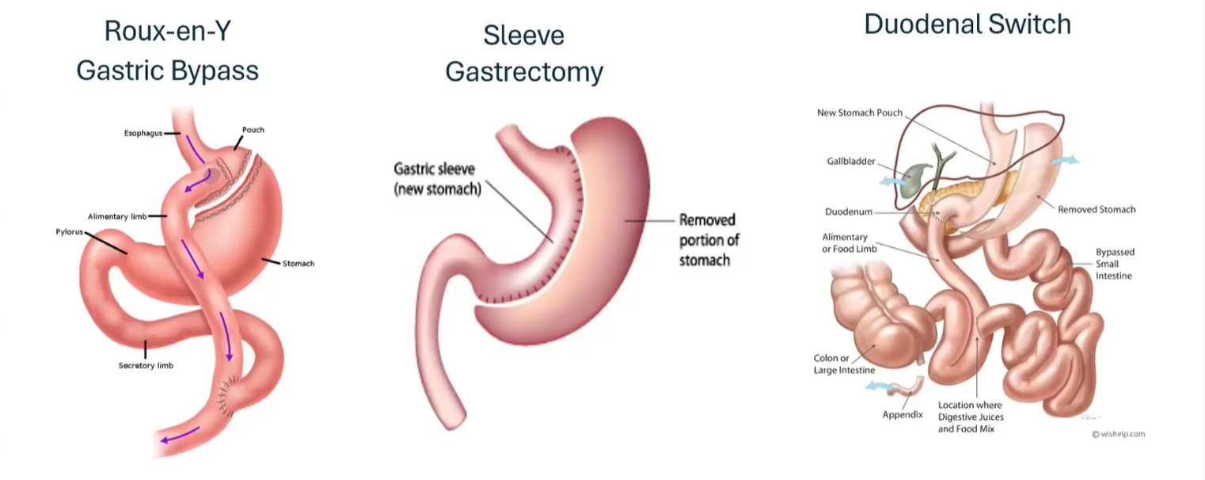
Types of Bariatric surgeries

Slide 61
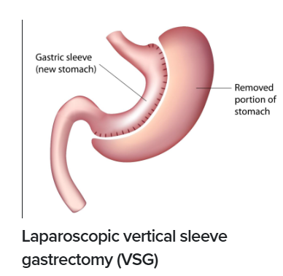
Sleeve gastrectomy
80 percent of the stomach is removed
Significantly reduces the amount of food and calories consumed
Expected excess weight loss at 2 years: 50 - 70%
(Excess weight loss - percent of weight lost in excess of ideal body weight)
Optimal candidates - Metabolic disease
Pros - Improves metabolic disease, maintains small intestinal anatomy, micronutrient deficiencies infrequent
Cons - No long term success data, irreversible

Slide 62
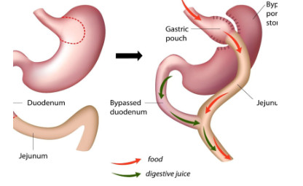
Roux- en -Y Gastric Bypass
Stomach is completely divided into a small proximal gastric pouch leaving a large “bypassed” gastric remnant in situ
The pouch is attached to a “roux” limb of small bowel , bypassing large gastric remnant, all of the duodenum and portion of proximal small intestine
Optimal candidates - Higher BMI, GERD, Type 2 DM
Expected excess weight loss at 2 years:60 - 75%
Pros - Greater improvement in metabolic disease
Cons - Increased risk of malabsorptive complications

Slide 63
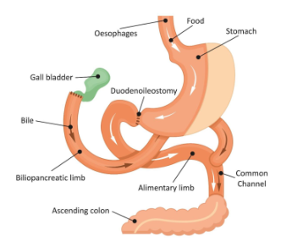
Biliopancreatic Diversion with Duodenal switch
Partial gastrectomy removing 70- 80%greater curvature of the stomach sparing pylorus and a small portion of the duodenum and creation of a Roux en Y duodenoenterostomy bypassing a large portion of the intestine
Optimal candidates - Higher BMI, Type 2 DM
Expected excess weight loss at 2 years:70- 80%
Pros - Greatest amount of weight loss and resolution of metabolic disease and resolution of metabolic disease
Cons - Increased risk of macro and micronutrient deficiencies over bypass

Slide 64
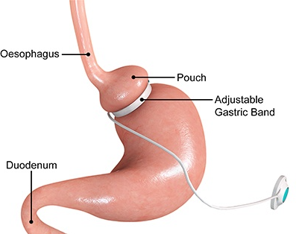
Laparoscopic adjustable gastric banding
An adjustable band is placed around the upper stomach creating small pouch
The band diameter is adjustable through the percutaneous introduction of saline via subcutaneous port which is accessed in the upper abdomen
Optimal candidates - Lower BMI, No metabolic disease
Expected excess weight loss at 2 years:30-50%
Pros - Least invasive, removable
Cons - 25- 40% 5 year removal rate

Slide 65

Post surgical care
Important to have long term follow up
Labs including CBC, Iron, Vitamin B12, Folic acid, Vitamin D, PTH and thiamine a month after surgery then at 6 months and then annually is recommended
Short term complications: vomiting, wound infection, stomal stenosis, marginal ulcer, constipation
Long term complications: cholelithiasis, dumping syndrome, persistent vomiting, nutritional deficiencies
Weight regain - is a possibility. Behavioral interventions and pharmacological therapy are useful

Slide 66

Take home points
Chronic disease process causing illness
Excess adipose tissue causing metabolic and physical dysfunction
Can happen at any point in life
Remitting, relapsing
Multifactorial
Lifelong - will constantly need treatment
Usually requires combination therapy
Nutrition
Intentional physical activity
Medication(s)
Surgical intervention
Treatment and goal are moving targets
Improvement of overall health
Target is NOT singularly BMI or weight focused
Depends on age, metabolic health, starting point of treatment, physical limitations

